Slide 1


Slide 2


Slide 3
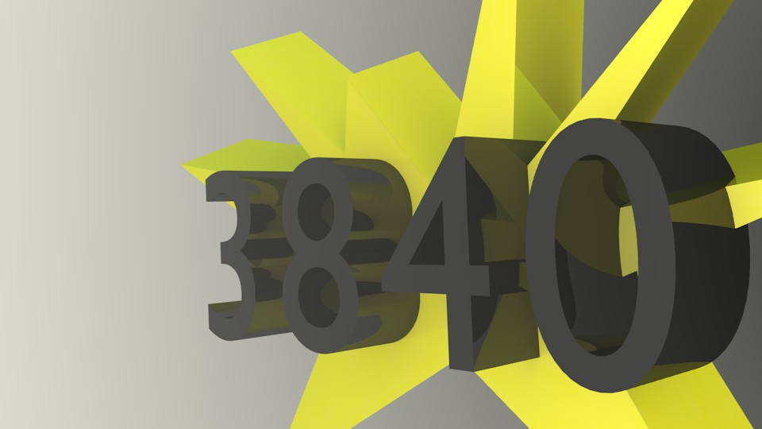
The FRC Control System
Notes:
Start
3

Slide 4


Brought to you by Teens ‘Nto Technology (TNT)

Slide 5
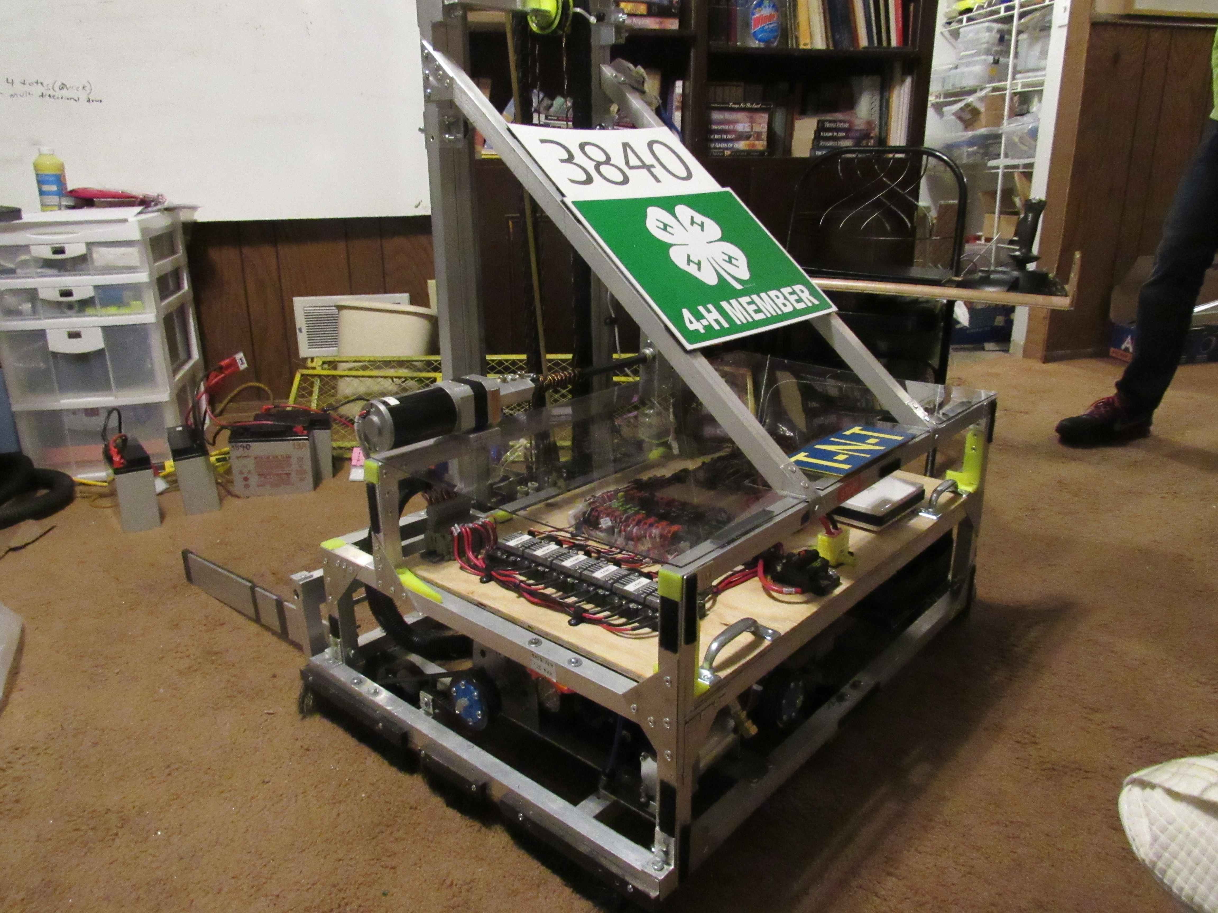
Table of Contents
Power Distribution Panel (PDP)
Pneumatics Control Module (PCM)
Voltage Regulator Module
Motor controllers:
Talon, Victor, Spark
Radio
RoboRio
MPX
Wiring tips

Slide 6
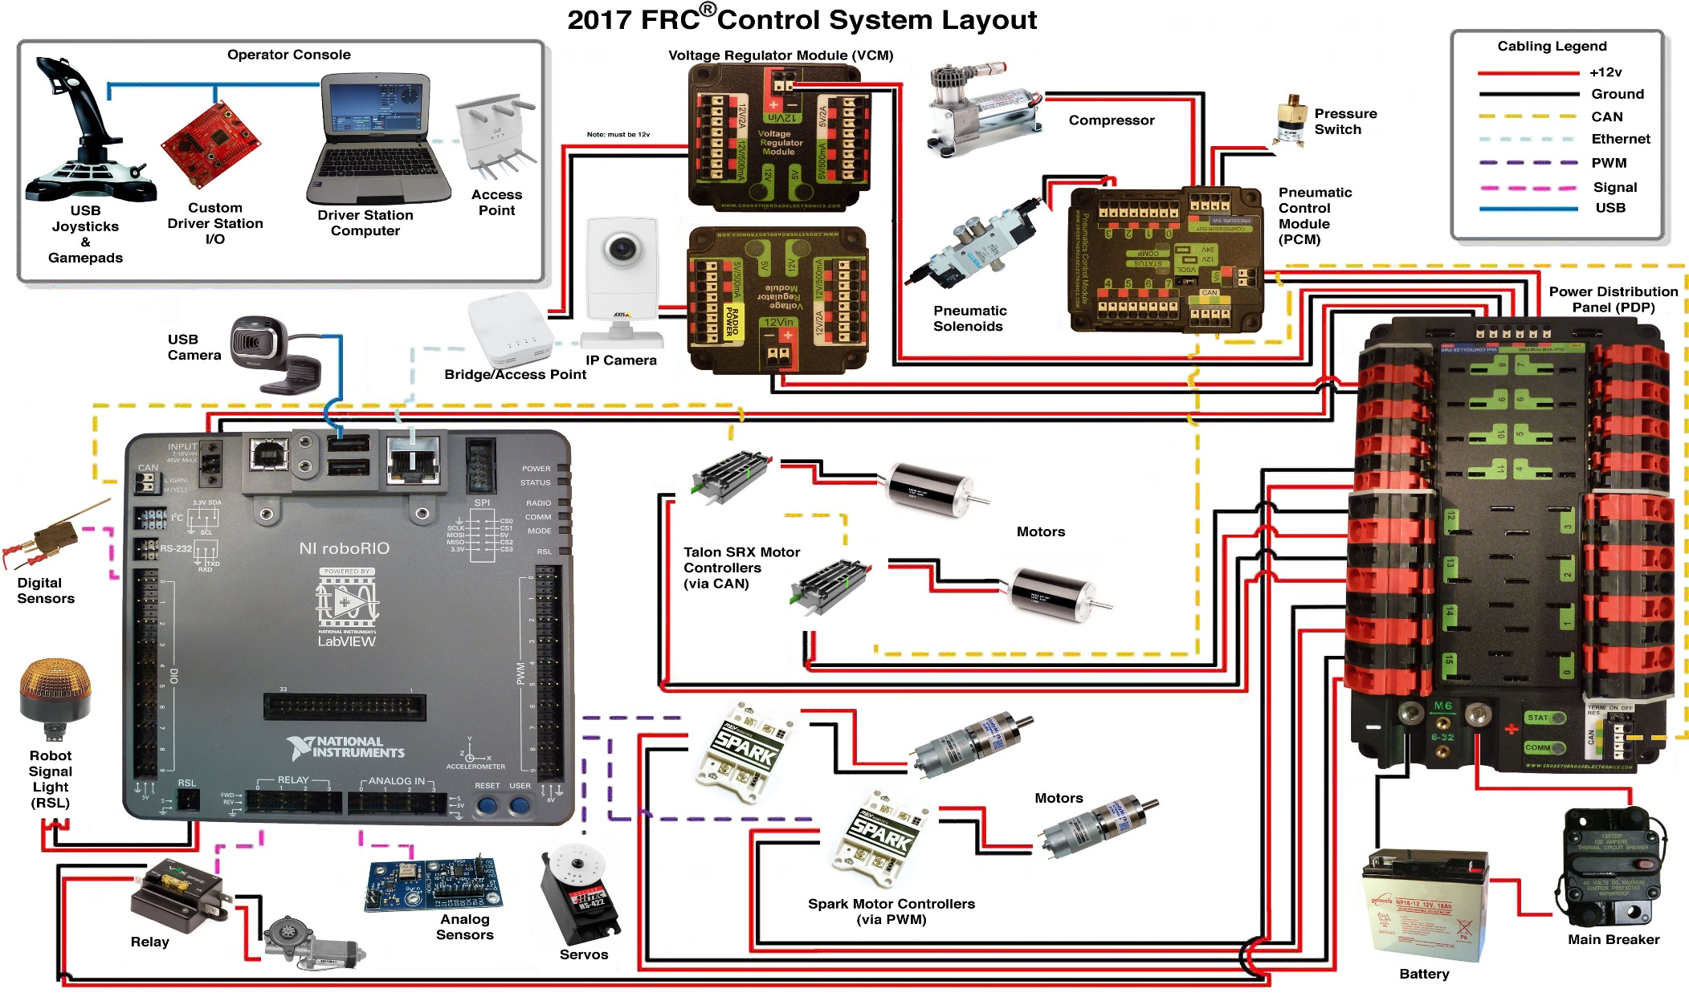
Notes:
Never ground to frame!!
Ethernet camera not recommended.

Slide 7
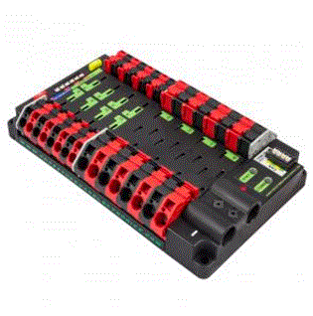
Power Distribution Panel (PDP) cont.
PDP control system:
Function is to
distribute power
to the rest of
the components.
Notes:
no regulated outputs, less ports/ smaller for the 20 30 amp, allows you to monitor the current across any breaker.
you need to use crimp battery connectors on the wire for connecting to the PDP.
has CAN-must be used.

Slide 8
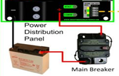
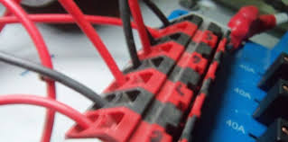
PDP Use
The panel is hooked up to the battery through the main breaker
The motor controllers are then plugged into the Power Distribution Panel to operate the robot
Notes:
hooked up same way as in the old control system

Slide 9
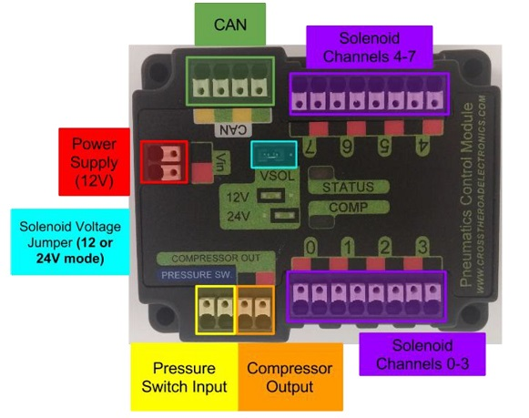
Pneumatics Control Module (PCM)

Slide 10
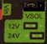
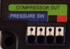
Pneumatics Control Module Function
Controls all the components for the pneumatics system
The PCM is controlled through CAN and can be
switched from 12V to 24V
The PCM has specified ports for the compressor and
the pressure switch
Notes:
In the past, compressor had to be run from spike through digital side car. No programming for compressor

Slide 11
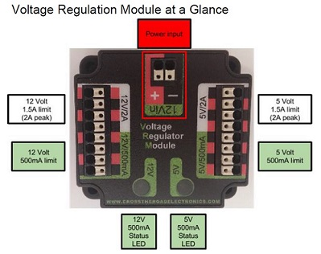
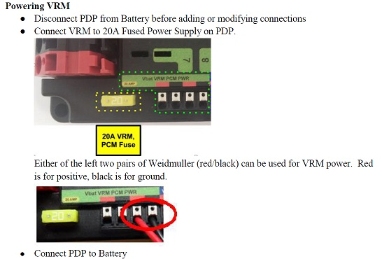
Voltage Regulator Module Function
It provides 500ma or 2A peek at both 5 and 12 volts. Power is supplied from one of the fused connectors on the Power Distribution Panel.

Slide 12
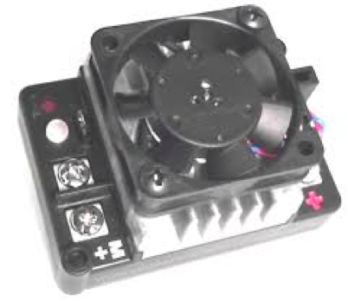
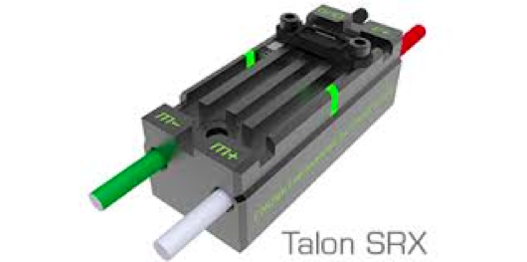
Motor Controllers
Motor controllers control the speed produced by the motors, as well as regulate the speed variation.
List of legal motor controllers are located on the FRC blog post at: http://www.firstinspires.org/node/3651
Notes:
the motor controllers are like the appendages
there are four different types of motor controllers

Slide 13
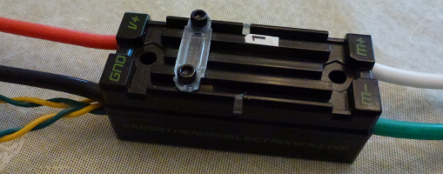
Talons
Talons are a type of motor controller, the old talon has the option to attach a fan to keep the motor controller cool when it is running for a long period of time.
The talon SRXs are smaller and more compact. They also have pre-attached wires; which makes sure the wires won’t come off, but can hinder reusability.
Notes:
Talons
new version this year
linear
small footprint
Variable speed control
PWM

Slide 14
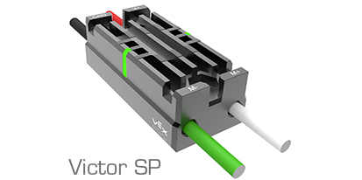
Victors
Another motor controller, the Victor is slightly smaller
than the talon.
Less risk of shavings getting stuck in the victor SP. The victor also has pre-attached wires, which makes sure the wires won’t come off, but can hinder reusability for future seasons
Notes:
Victors
variable speed control
PWM
two kinds
888 (newer)
884 (older. can’t get anymore. can still use)
not linear (888 is more linear than 884)
come with fans

Slide 15
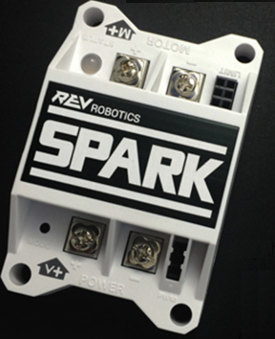
Spark
The Spark is about the same size as the Talon SR.
The Spark features 60A continuous current with passive cooling, bi-directional limit switch inputs for smart mechanism control, an RGB LED status indicator, and a button-activated brake/coast mode.
Notes:
Spark
variable speed control
PWM
Limit switch input
come with no fans

Slide 16
Talon, Victor and Spark Wires
Talons, Victors and Sparks should be close to the PDP so that wires don’t have to be lengthened or shortened
The wires on the motor side should utilize connectors so they don’t need to be shortened every year until they are unusable.

Slide 17
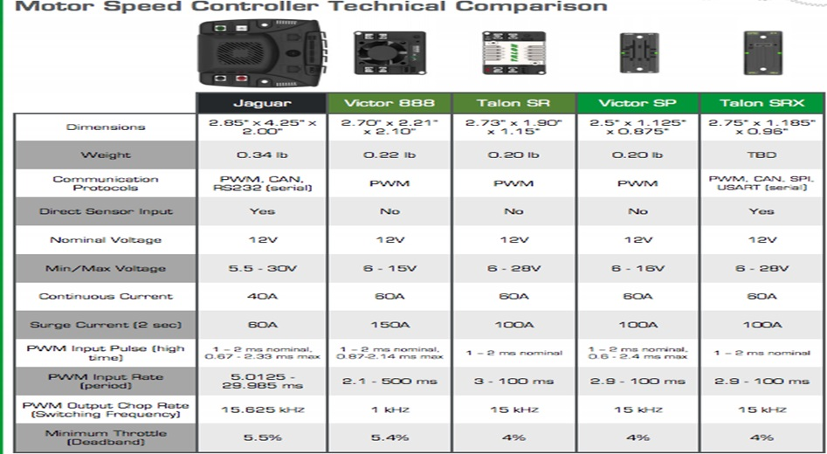

Slide 18
Questions?

Slide 19
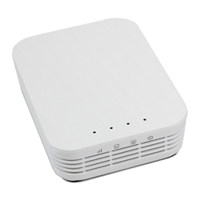
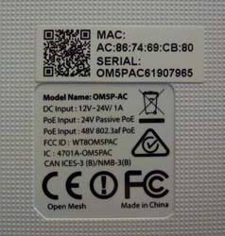
2017 Wireless Radio
The best orientation to mount the radio in on the robot is horizontally away from metal and sources of electronic RF noise, such as the VRM and battery. The antennas are positioned along the edges of the case (the three sides without the connectors). So mounting this radio horizontally will maximize the antenna radiation in the horizontal plane of the playing field. In 2017 the AN model has been superceeded by an almost identical AC model. This one has a completely flat top and vents only on the sides, not on the bottom, allowing for easier and more varied mounting options.
Notes:
POE -300ft

Slide 20
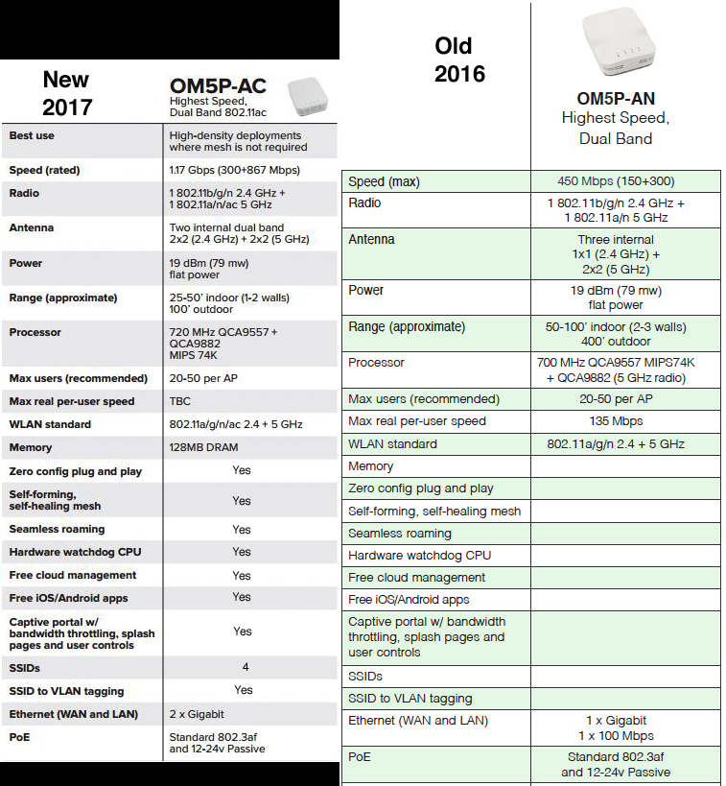
2017 Wireless Radio
Both of these radios can be powered either by a barrel connector and/or a passive POE injector, but the 12v power required should come from a competition legal VRM. In fact, for redundant power you can connect both POE and a barrel connector 12v power, if one flickers the other takes over preventing and avoiding a time consuming radio reboot.

Slide 21
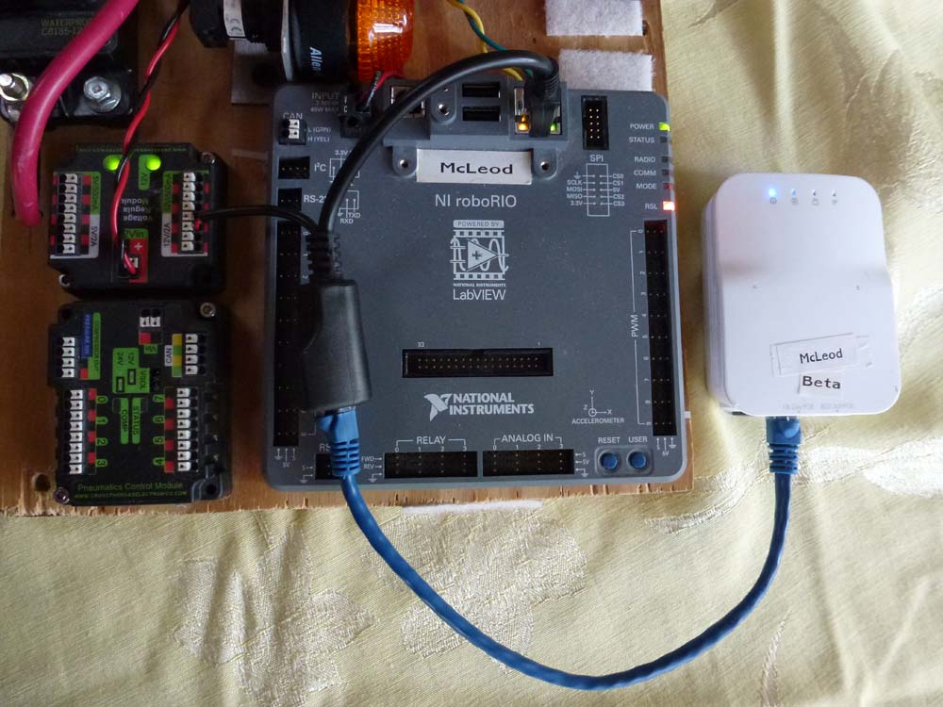
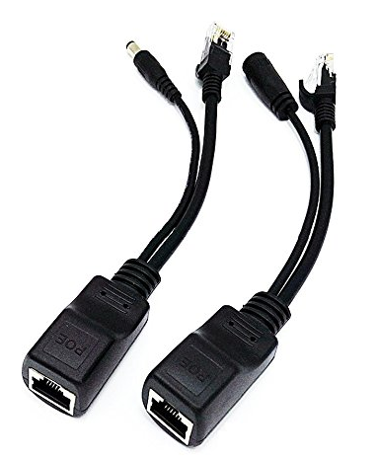
2017 Wireless Radio
iCreatin Passive PoE Injector and PoE Splitter Kit with 5.5x2.1 mm DC Connector *Passive Power Over Ethernet Injector (am-3766)
https://www.amazon.com/iCreatin-Passive-Injector-Splitter-Connector/dp/B00NRHNPUA/ref=sr_1_19?ie=UTF8&qid=1486416072&sr=8-19
Notes:
WARNING: This is a 12 volt device (unlike the old DLink) and requires the use of the VRM 12v/2a power for use on the competition robot.

Slide 22
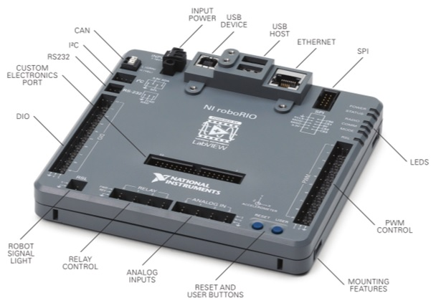
Parts of the RoboRio
Notes:
Analog inputs - sensors
Relay controls -
the part called the CEP will be talked about a little later.
SPI RS232 and I2C -
CAN port
M4 mounts

Slide 23
The RoboRio
The RoboRio uses NI Real-Time Linux OS, which is used in most of NI new Rio Devices
The RoboRIO has 3 mounting features
2 ways to zip tie the RoboRIO down
1 way to bolt the RoboRIO into place

Slide 24
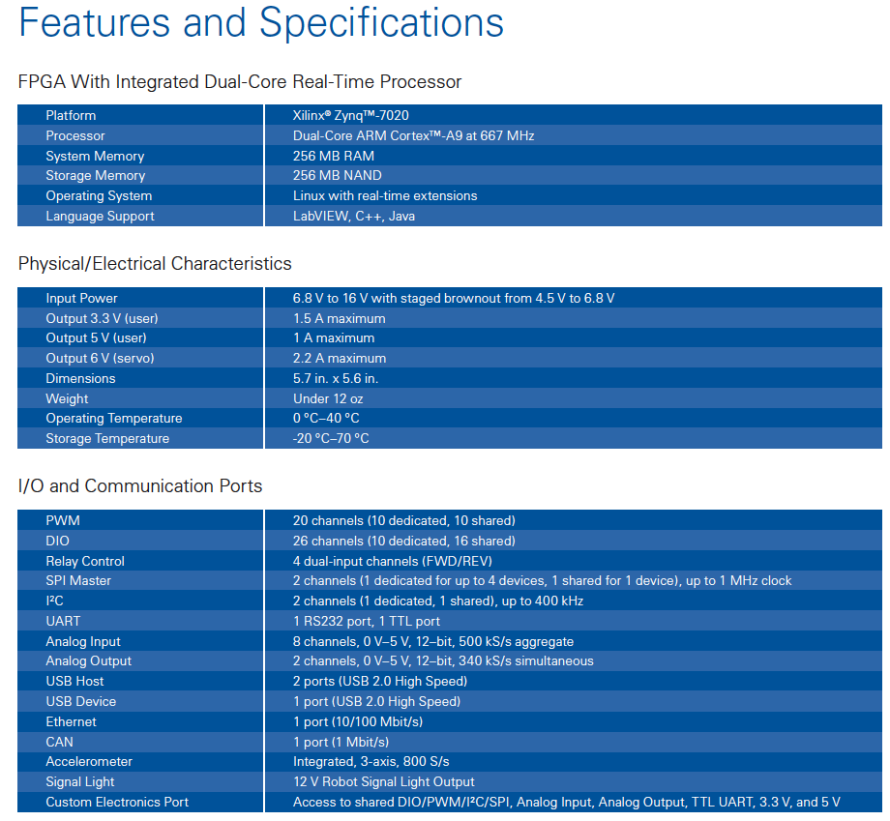

Slide 25
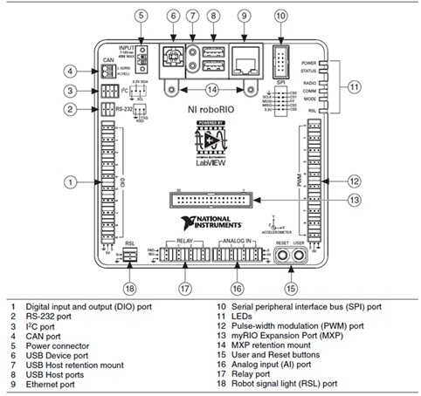
Connectivity details
Notes:
End CAN in PDP with termination jumper enabled or with a termination resistor.
25

Slide 26
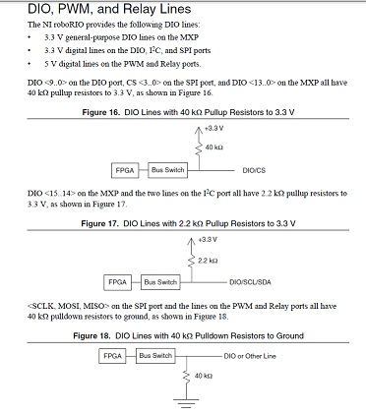
DIO resistor configuration
(3) PWM 0-9 (shared w/DIO)
(4) Analog Input 0-3 (0-5v, 12-bit, 500kS/s aggregate)
(1) TTL (max baud 230,400 bps, 3.3v but 5v tolerant-use either)
(1) SPI (master-supports 1 device) (shared w/DIO 4-7)
(1) I2C (shared w/DIO 14-15, 3.3v but 5v tolerant)
(7) Digital GND pins for Signal reference: 8,12,16,20,24,28,30 (for DIO, TTL, I2C, SPI, PWM)
(1) Analog Signal reference GND pin: 6 (for both analog input & output)
(2) Analog Output (3mA, 0-5v, 12-bit, 340kS/s simultaneous)
(1) 3.3v power - 1.5A max
(1) 5v power - 1A max
Notes:
4mA on DIO 0-9
7mA on relay ports
26

Slide 27
Custom Electronics Port
Allows the expansion of the of the Control System I/O based on the specific needs
-Preliminary Definitions:
Active Device or Circuit: Any device or circuit capable of dynamically controlling and/or converting a source of electrical energy by the application of external electrical stimulus
MPX: myRIO Expantion Port (aka Custom Electronics Port)
Passive Device or Circuit: Any device or circuit whose capability is limited to the conduction and/or static regulation of the electrical energy applied to it (e.g. wire, splices, connectors, printed wiring board.)
Notes:
say the frc blog post about the MPX

Slide 28
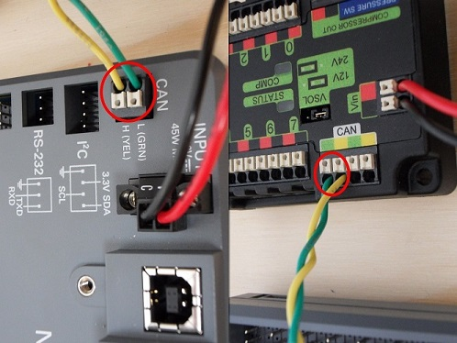
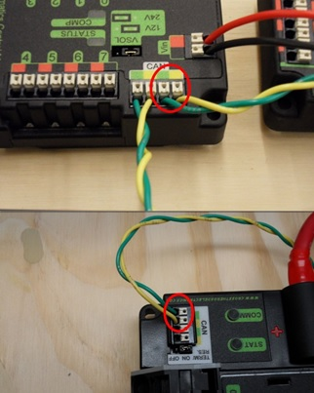
CAN Connection

Slide 29
Questions?

Slide 30
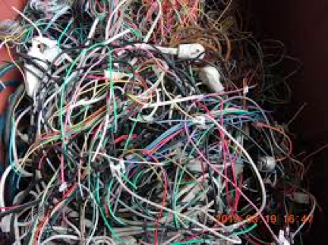
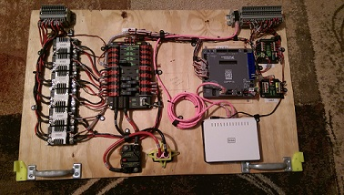
Wiring Tips: Wire Placement
Any components connected by wires should be put as close together as possible so wires can be conserved & the board kept cleaner and lighter.
Notes:
DESIGN
Color coding
numbering
thinking about spacing on electrical board
what kind of layout for board
take into account size of components

Slide 31
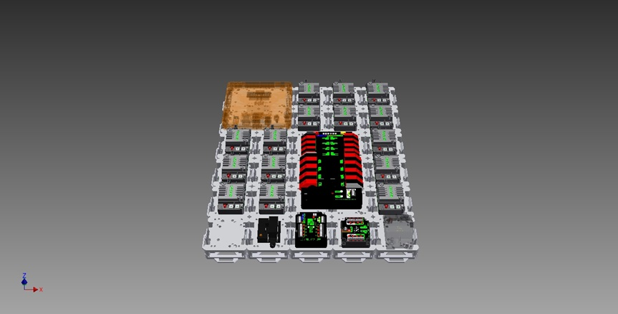
T811 Modulus Kit (am-2926)

Slide 32
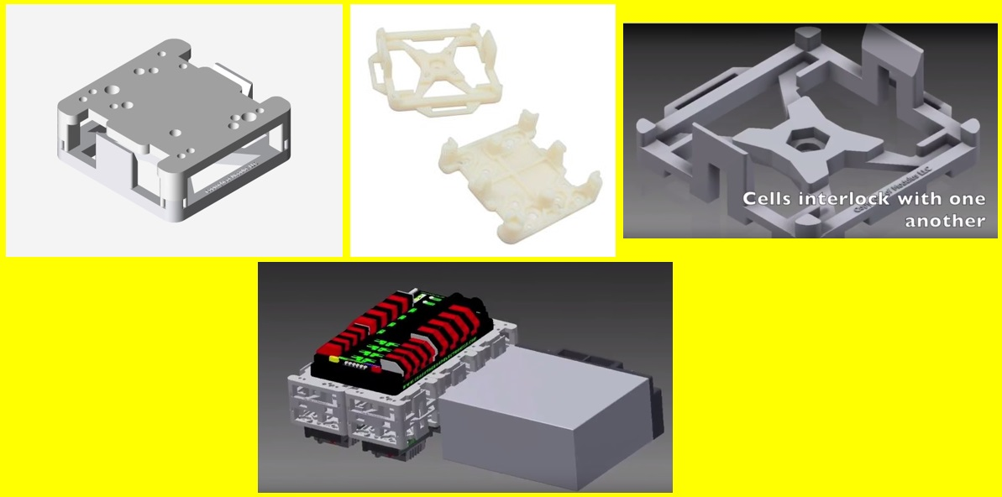
T811 Modulus Kit (am-2926)
Stacking components

Slide 33
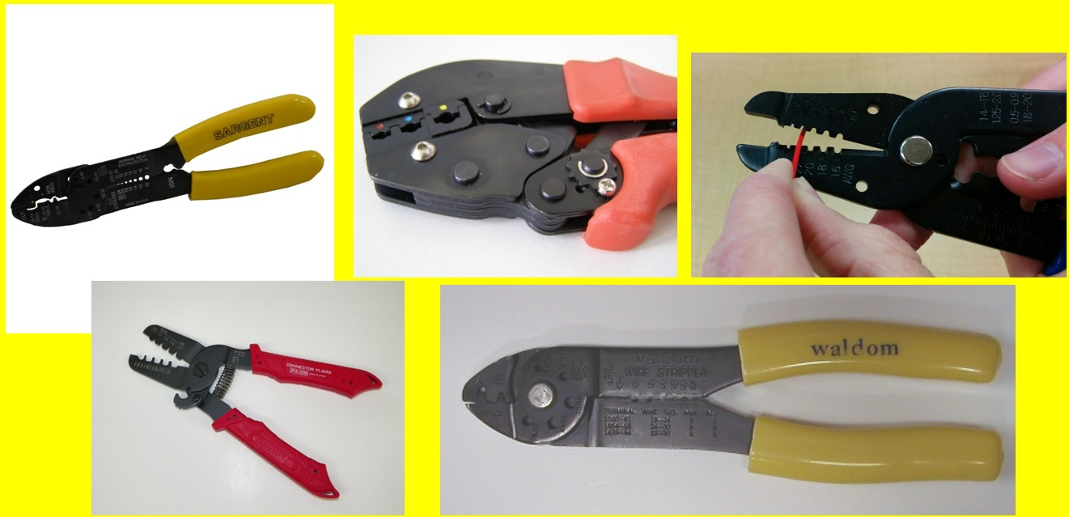
Electrical Tools
Notes:
Make sure to use the write striper size for the gage of wire that your using.
33

Slide 34
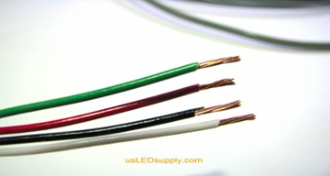
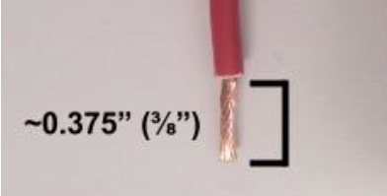
Wire Cutting
Try to keep wires just as long as you need them to form the needed connection
Initially wires are cut to be a 3-6 inches longer so wires can be cut shorter if needed
Notes:
materials for electrical board
non conductive
lexan, wood, something or something like that
electrical board location
central location
organization of board
leave room for routing wires
zipties
tiedowns

Slide 35
Wire Cutting cont.
Measure needed wire’s length and cut the wire 3-6 inches longer than necessary
Solder on the needed connectors and power pulls for your wire.
Connect the wire to where it needs to go
Properly adjust wire length so it can be attached to power supply (PDP)
Notes:
overall note: make sure you are saying more than just what is written on the slides. I recommend using this handy dandy notes section to remind you of what you are going to say outside of what is written

Slide 36
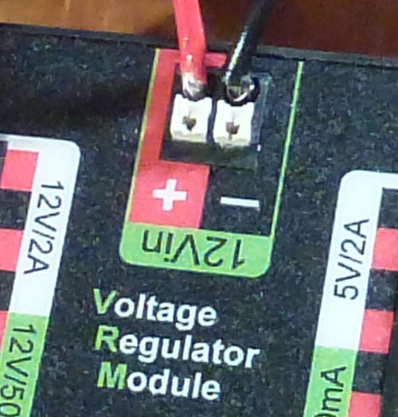
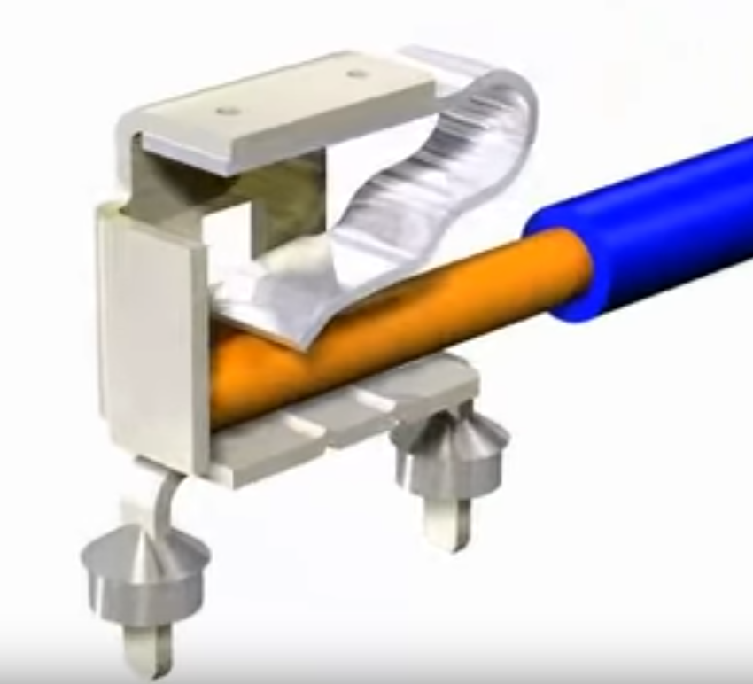
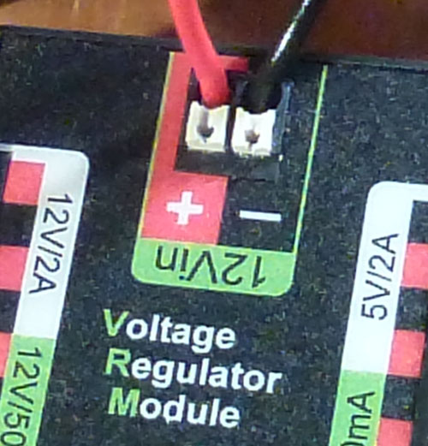
Ensure Proper Connection

Slide 37
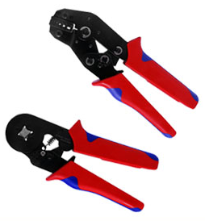
Ferrule Connections

Slide 38
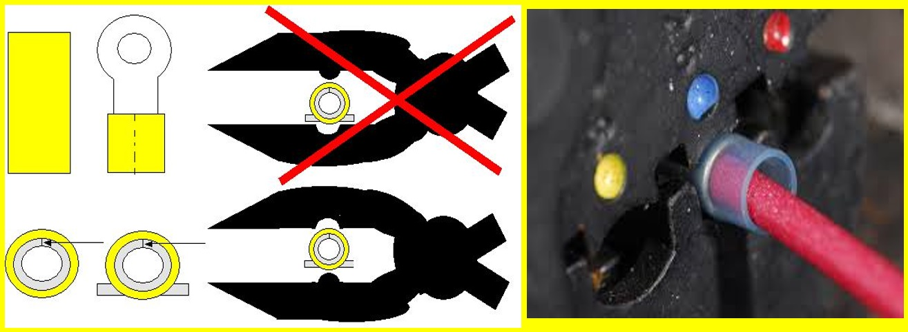
Proper Wire Crimping
Notes:
Make sure you crimp the wires the correct way. Also make sure you use the correct size connecter and crimper size.
38

Slide 39
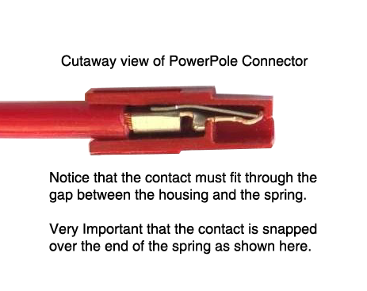
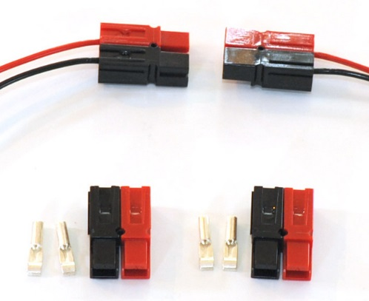
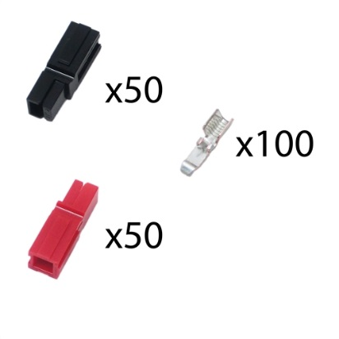
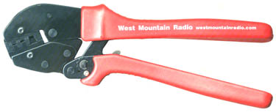
Anderson Powerpole Connector
Notes:
Use these connectors for motors.

Slide 40
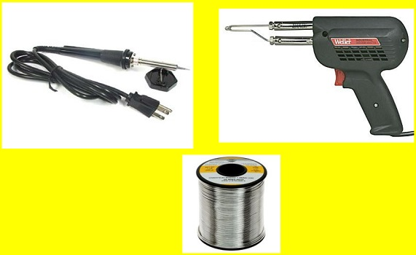
Soldering Techniques

Slide 41
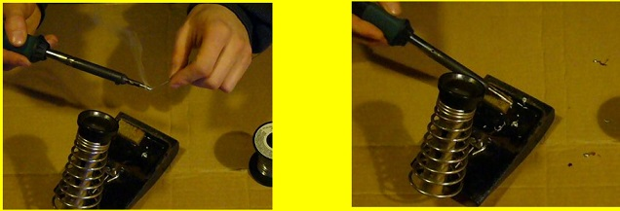
Soldering Techniques
Preparing To Solder
Tinning The Soldering Tip
Before use, a new soldering tip, or one that is very dirty, must be tinned.
"Tinning" is the process of coating a soldering tip with a thin coat of solder.
This aids in heat transfer between the tip and the component you are soldering,
and also gives the solder a base from which to flow from.

Slide 42
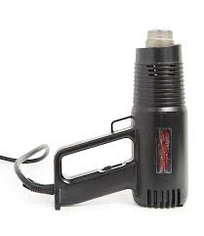
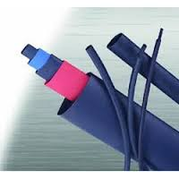
Heat shrink
Heat shrink tubing is a shrinkable plastic tube used to insulate wires, providing abrasion resistance and environmental protection for stranded and solid wire conductors, connections, joints and terminals in electrical engineering. It can also be used to repair the insulation on wires or to bundle them together, to protect wires or small parts from minor abrasion, and to create cable entry seals, offering environmental sealing protection. Heat shrink tubing is ordinarily made of nylon or polyolefin, which shrinks in one plane only (its diameter) when heated, to between one-half and one-sixth of its diameter.
Notes:
Heat shrink tubing shrinkable plastic
42

Slide 43

Color Coding or labeling
Use vinyl marking tape to color code & use two different colors per set of wires or label the wires.
This streamlines servicing of the bot by showing where wires go.
Always use the same color wires for the CAN bus. (never the same colors as power wires)
Notes:
We put the two color combination at several points along the wire so we know which wires lead to which components from any point on the wire

Slide 44
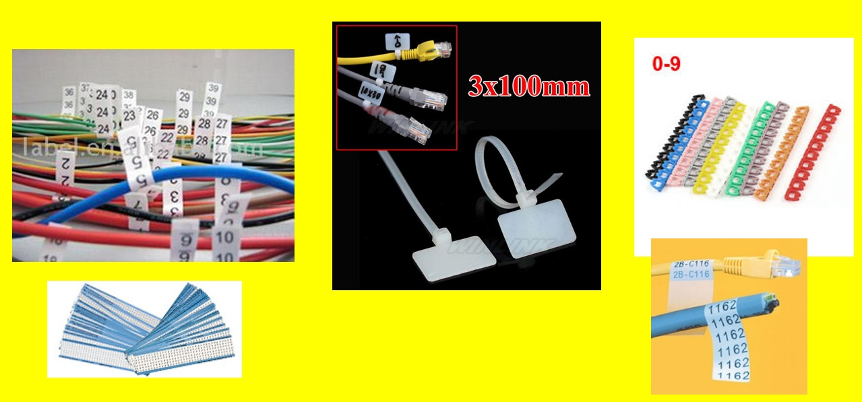
Wiring Labels

Slide 45
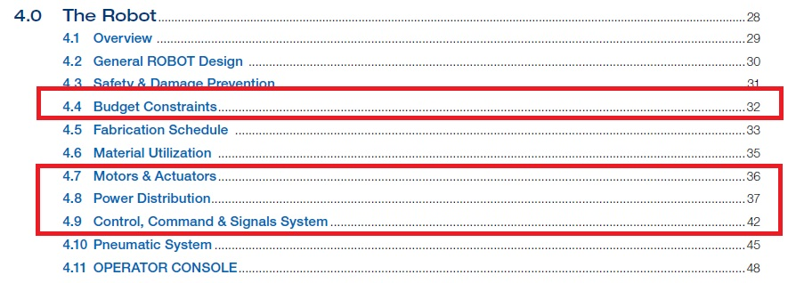
Ensure To Follow The Rules
From the Game Manual

Slide 46
Contact Us!
Website: team3840.org
Facebook: FIRST Team 3840
Email
tnt@team3840.org

Slide 47
Questions?

Slide 48



Thank you and good luck in 2018!
FIRST-Team-3840
tnt@team3840.org

